Slide 1
Unveiling Gender Bias:
An Eye-Tracking Analysis of Scene Perception
Naga Srija Gopisetty

Slide 2
Contents
Problem Statement
Research Questions
Literature Review
Methodology
Apparatus
Data Collection and preparation
Procedure
Data Logging and Real-Time Monitoring
Results and Analysis
Pupil Dilation
T-Tests
Cognitive load
Response Accuracy
Gaze Distribution
Qualitative Feedback
Conclusion

Slide 3
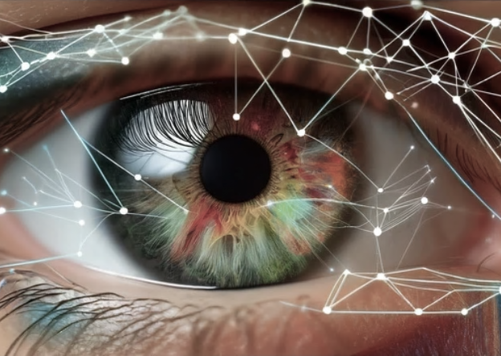
Problem Statement
Persistent Gender Bias: Despite efforts to address gender disparities, biases continue to influence attitudes and actions, subtly impacting scene perception and decision-making.
Complex Cognitive Processes: The relationship between gender bias and cognitive processing, as indicated by physiological responses such as pupil dilation, remains underexplored.
Technological Integration: Utilizing cutting-edge eye-tracking technology to monitor visual attention and cognitive load can provide deeper insights into how gender bias affects scene perception.
Experimental Investigation: Analyzing participant responses to gender-related scene modifications through controlled experiments can uncover underlying biases and inform strategies to mitigate their impact.

Slide 4
Research Questions
How does gender bias affect scene perception as measured by pupil dilation and eye movements?
What are the patterns of visual attention and cognitive load when participants are exposed to gender-related scene modifications?
Are there significant differences in the accuracy of identifying image replacements based on gender-related scene changes?
How do different types of gender-related scene modifications impact cognitive processing and emotional responses?

Slide 5
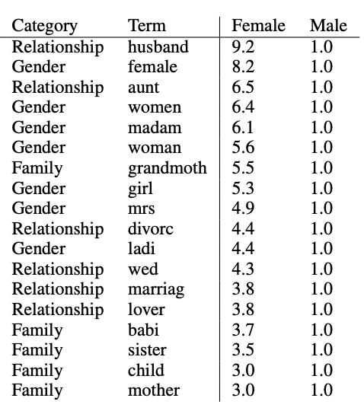
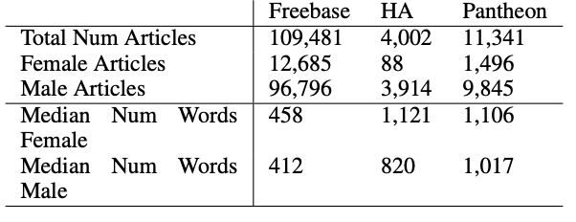
Literature Review
Wagner, C., Garcia, D., Jadidi, M., & Strohmaier, M. (2015). It’s a man’s Wikipedia? Assessing gender inequality in an online encyclopedia. Proc. of ICWSM.

Slide 6
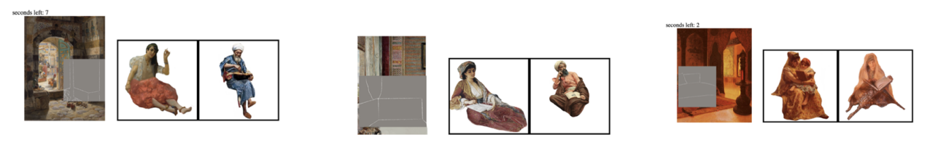
Literature Review
Albaghli, R., Chang, C., Almahmid, S., & Attar, N. (2022). Untraining Ethnocentric Biases about Gender Roles: A Preliminary Empirical Study Presenting Art as Stimulus. ACM.
Notes:
Middle eastern 19th century – exposed to various media and cultural norms – stereotypical gender roles - oppressed or sexualized entities

Slide 7
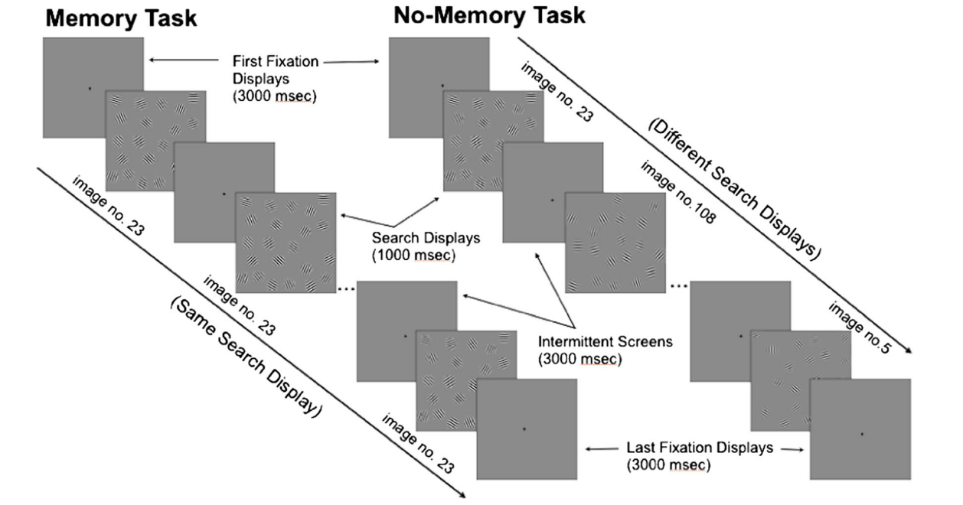
Literature Review
Attar, N., Schneps, M. H., & Pomplun, M. (2016). Working memory load predicts visual search efficiency: Evidence from a novel pupillary response paradigm. Memory & Cognition, 44(7), 1038–1049.

Slide 8
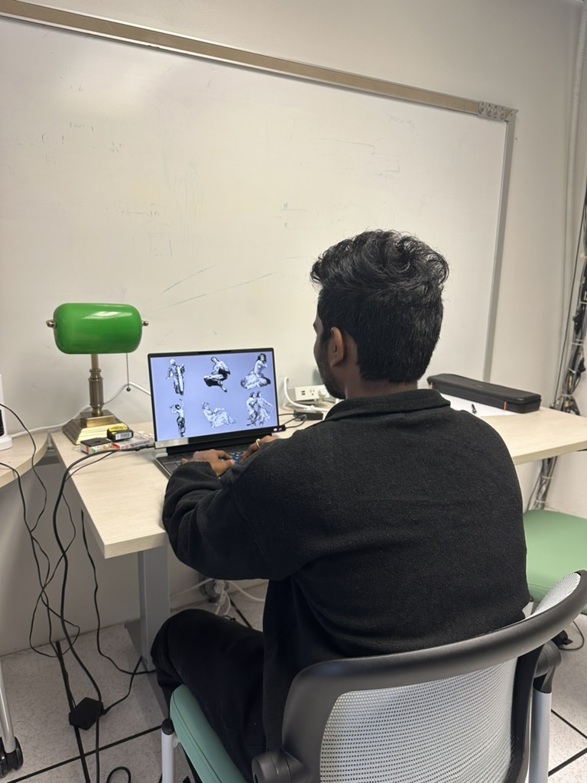
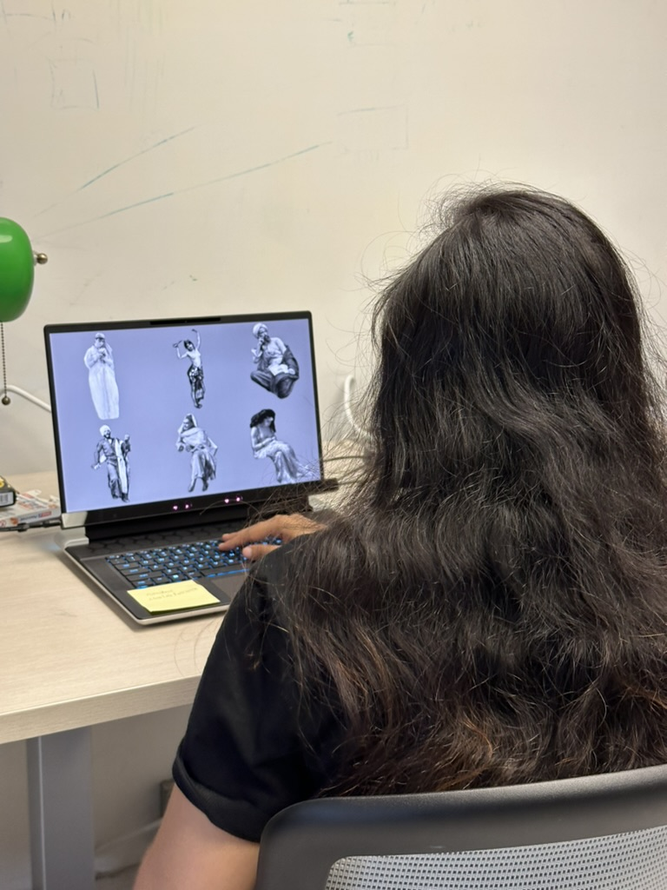
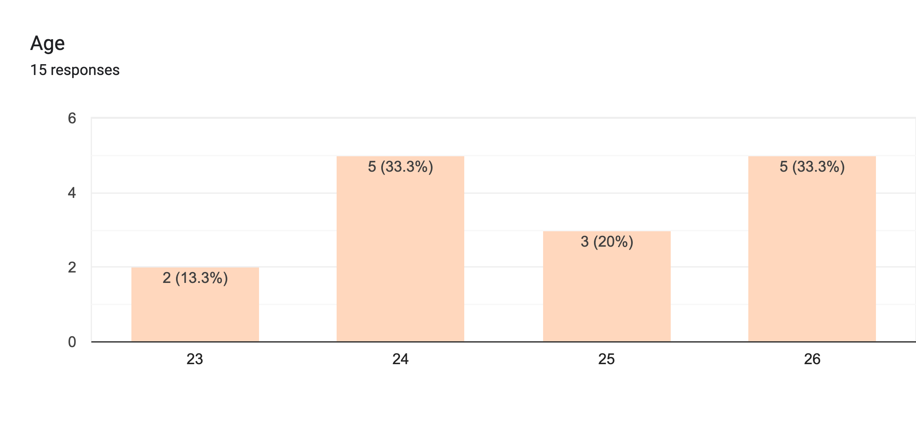
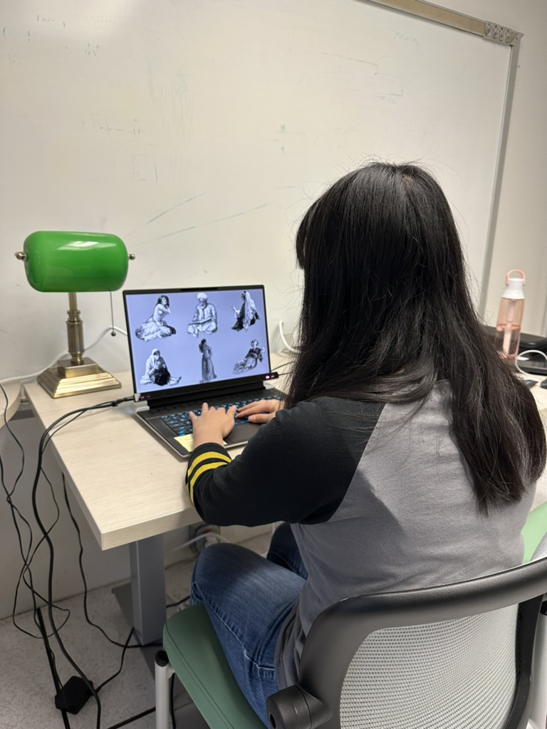
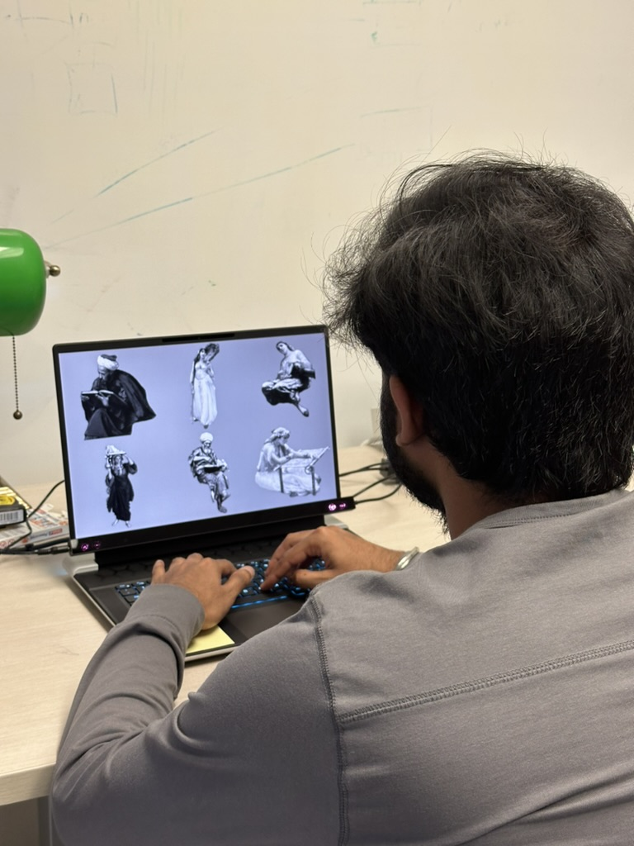
Methodology
Participant Selection

Slide 9
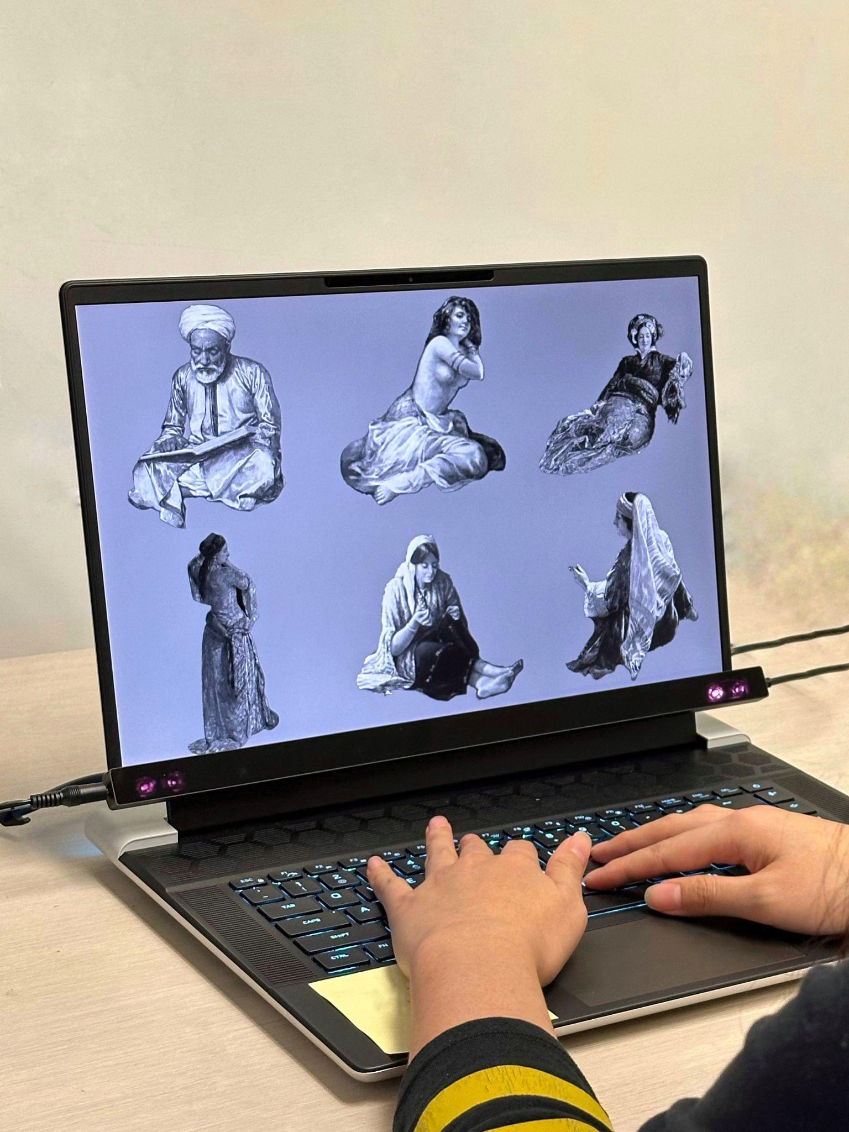
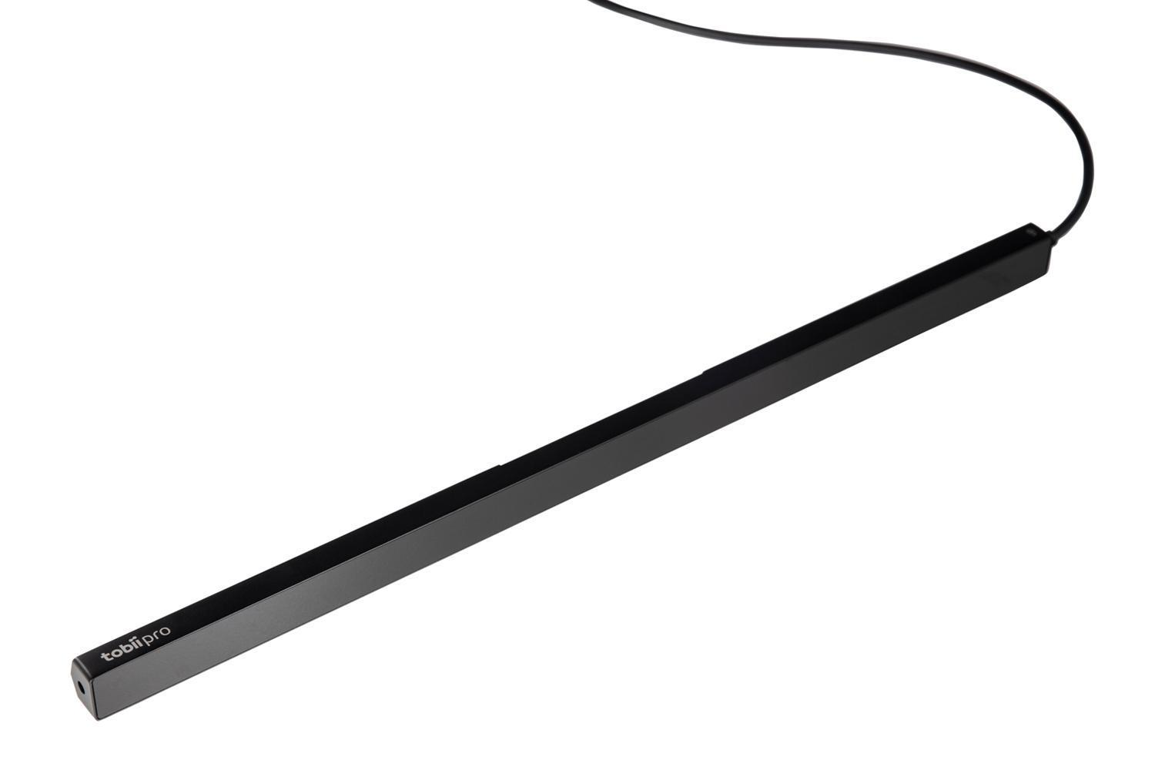
Methodology
Apparatus
Tobii Pro Fusion eye-tracker
Experiment Setup
Notes:
Alienware- Intel i9 process - 16.0" QHD+ (2560 x 1600) 240Hz 3ms

Slide 10
Python
Matplotlib
Titta
MATLAB
PIL
Pscyhtoolbox
Pandas
seaborn
Numpy

Slide 11
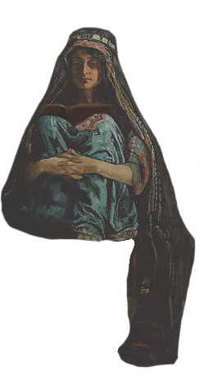

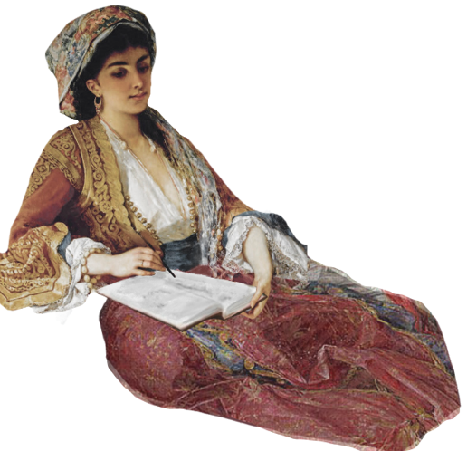
Methodology
Data Set
Sample Female Intellectual Image
Sample Female Ordinary Image
Sample Male Intellectual Image
FI
FO
MI

Slide 12
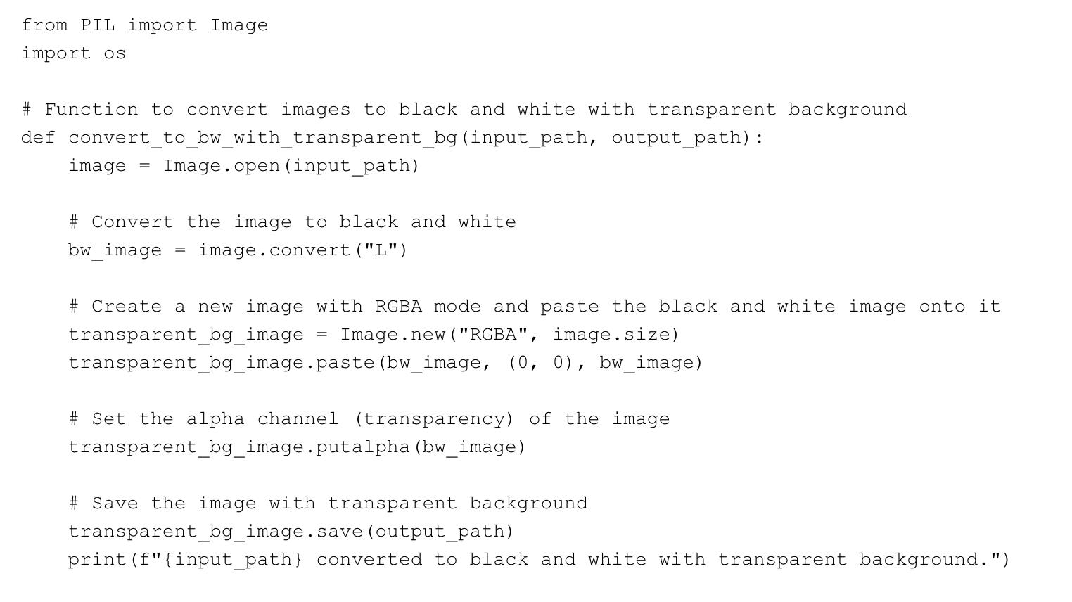


Methodology
Data Preparation
Python scripts to convert to grey scale

Slide 13
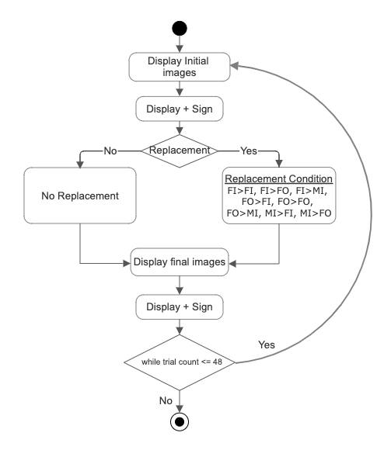
Methodology
Procedure
Experiment Workflow diagram
Notes:
Num of trials

Slide 14
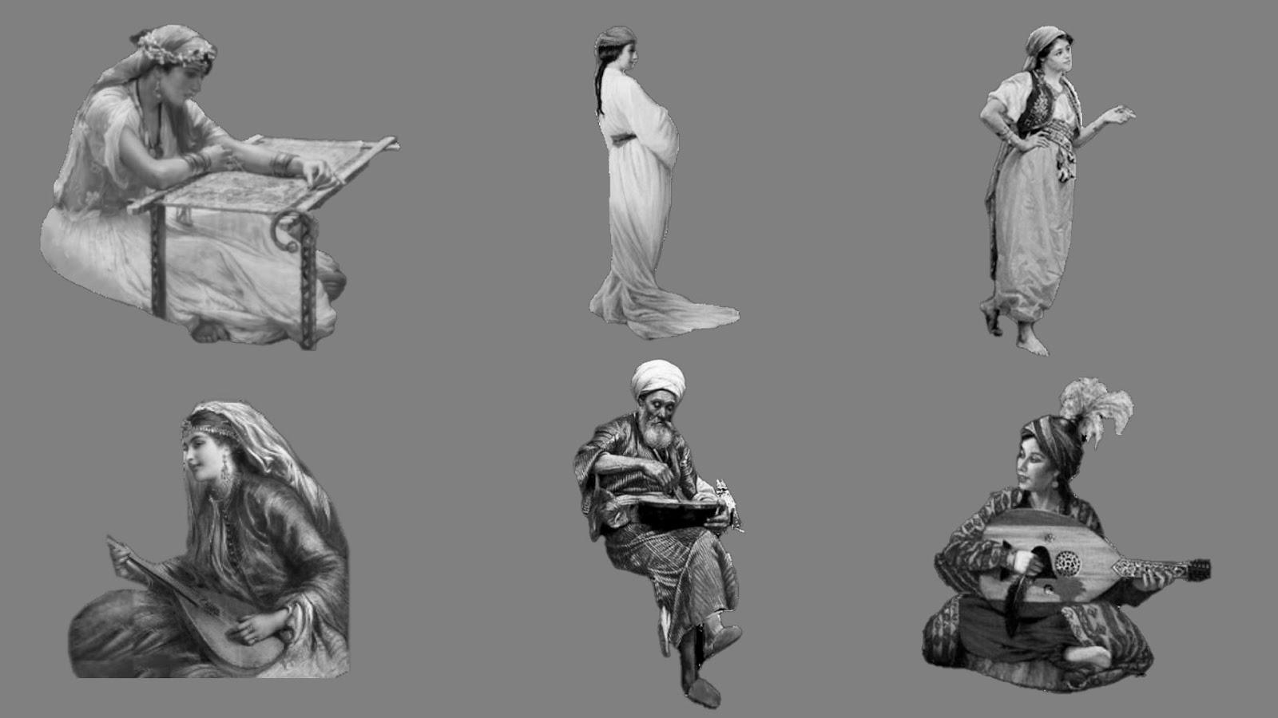
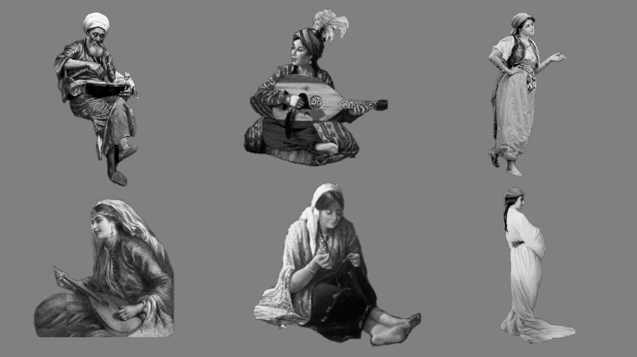
Methodology
Procedure
Initial 6 Images
Final 6 Images after replacement and shuffling
Notes:
Color, time

Slide 15
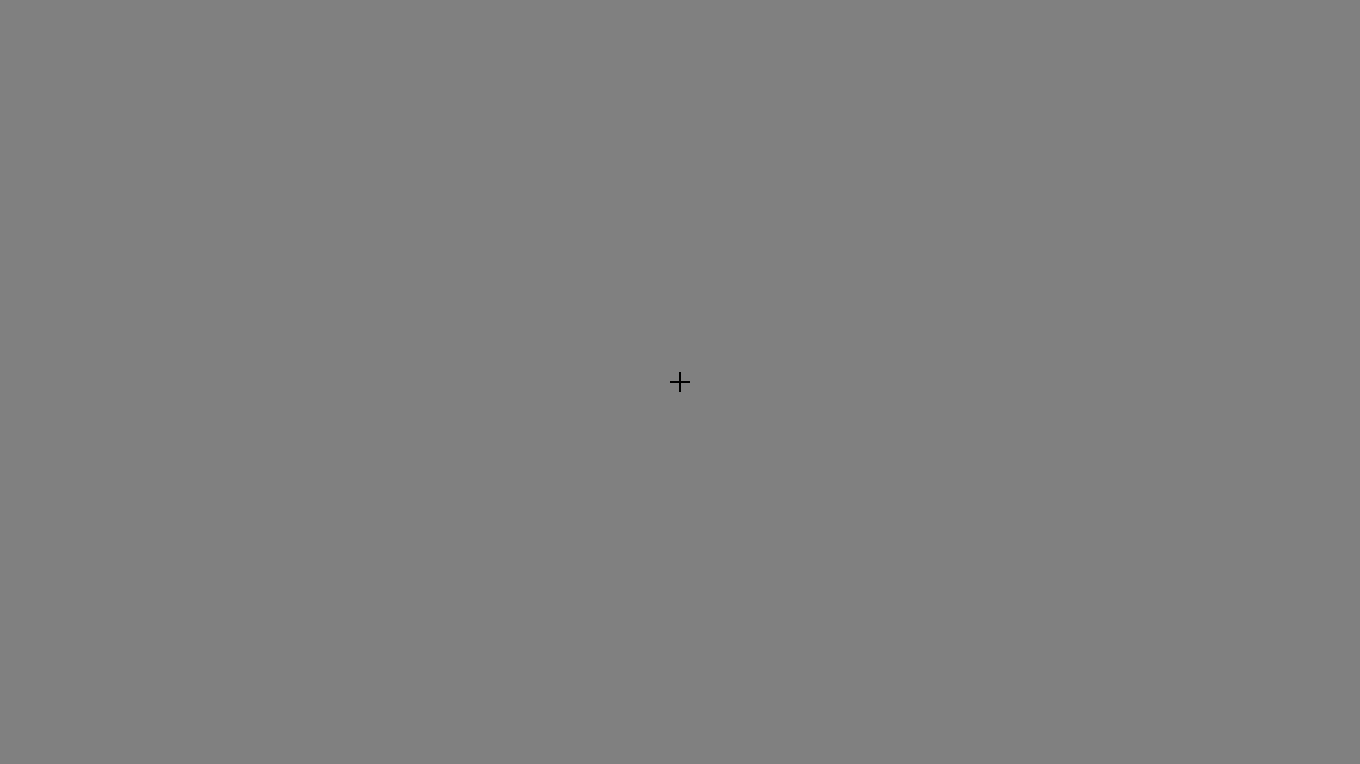
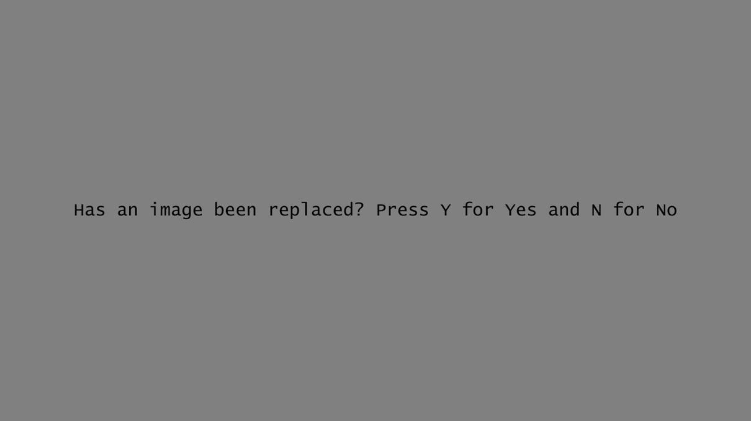
+ Sign
Question – Users need to respond

Slide 16
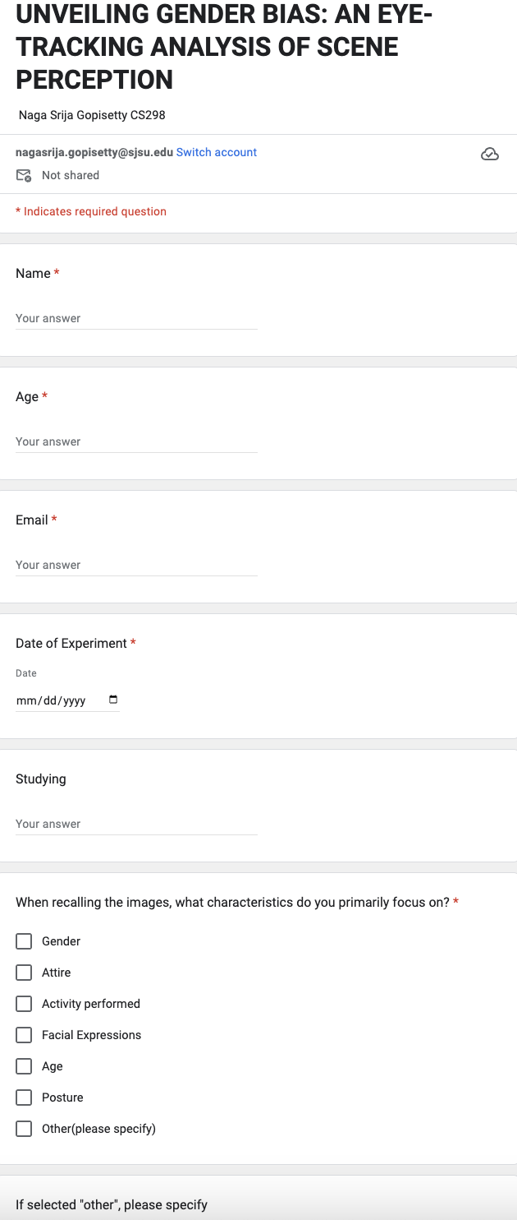
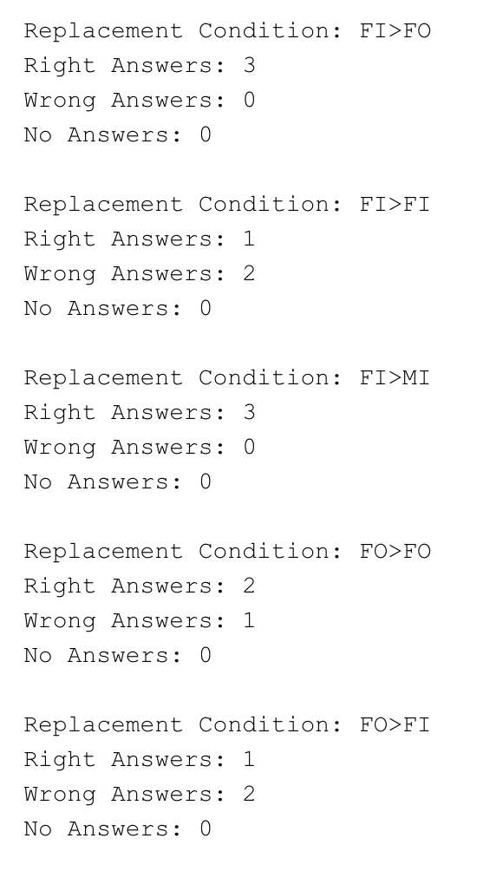
Data Logging and Real-Time Monitoring
trail_number | replace_image | replacement_condition | user_response | response_time | trail_mean_pupil_dilation
1 | 1 | FI>FI | Y | 0.9732 | 4.233728791
2 | 0 | No replacement | N | 2.1838 | 4.25874189
3 | 1 | MI>FI | N | 2.1542 | 4.273590725
4 | 0 | No replacement | N | 0.3945 | 4.24904328
5 | 1 | FI>FO | Y | 0.6969 | 4.025491727
6 | 0 | No replacement | Y | 0.7260 | 4.220349104
7 | 1 | FO>MI | N | 2.0117 | 4.364353597
8 | 1 | FO>FO | Y | 3.1286 | 4.414583502
9 | 0 | No replacement | N | 1.0490 | 4.439431028
10 | 1 | FI>FI | N | 3.4367 | 4.325301634
11 | 1 | MI>FO | N | 1.6333 | 4.449241144
12 | 1 | MI>FO | Y | 0.8664 | 4.24830767
13 | 0 | No replacement | N | 2.0683 | 4.288087813
14 | 1 | FI>FO | Y | 0.7824 | 4.26724979
15 | 0 | No replacement | N | 0.8256 | 4.339058348
16 | 0 | No replacement | N | 1.7516 | 4.324662485
17 | 0 | No replacement | N | 1.1665 | 4.278001162
18 | 0 | No replacement | N | 1.5880 | 4.39906671
19 | 0 | No replacement | N | 0.9512 | 4.227464945
20 | 1 | FO>FO | N | 0.6595 | 4.332804153
Processed data from eye tracker
User Input evaluation during the experiment
Participant Responses collected from Google Forms

Slide 17


.mat files(300MB)
.xlsx files(50MB)
Processed excel file(7KB)
trail_number | replace_image | replacement_condition | user_response | response_time | trail_mean_pupil_dilation
1 | 1 | FI>FI | Y | 0.9732 | 4.233728791
2 | 0 | No replacement | N | 2.1838 | 4.25874189
3 | 1 | MI>FI | N | 2.1542 | 4.273590725
4 | 0 | No replacement | N | 0.3945 | 4.24904328
5 | 1 | FI>FO | Y | 0.6969 | 4.025491727
6 | 0 | No replacement | Y | 0.7260 | 4.220349104
7 | 1 | FO>MI | N | 2.0117 | 4.364353597
8 | 1 | FO>FO | Y | 3.1286 | 4.414583502
9 | 0 | No replacement | N | 1.0490 | 4.439431028
10 | 1 | FI>FI | N | 3.4367 | 4.325301634
11 | 1 | MI>FO | N | 1.6333 | 4.449241144
12 | 1 | MI>FO | Y | 0.8664 | 4.24830767
13 | 0 | No replacement | N | 2.0683 | 4.288087813
14 | 1 | FI>FO | Y | 0.7824 | 4.26724979
15 | 0 | No replacement | N | 0.8256 | 4.339058348
16 | 0 | No replacement | N | 1.7516 | 4.324662485
17 | 0 | No replacement | N | 1.1665 | 4.278001162
18 | 0 | No replacement | N | 1.5880 | 4.39906671
19 | 0 | No replacement | N | 0.9512 | 4.227464945
20 | 1 | FO>FO | N | 0.6595 | 4.332804153
["system time", "message"," device time","leftGazePointDisplay","leftGazePointDisplay","leftGazePointCoords","leftGazePointCoords","leftGazePointCoords","leftGazeOriginDisplay","leftGazeOriginDisplay","leftGazeOriginDisplay","leftGazeOriginCoords","leftGazeOriginCoords","leftGazeOriginCoords","leftPupilDiameter","rightGazePointDisplay","rightGazePointDisplay","rightGazePointCoords","rightGazePointCoords","rightGazePointCoords","rightGazeOriginDisplay","rightGazeOriginDisplay","rightGazeOriginDisplay","rightGazeOriginCoords","rightGazeOriginCoords","rightGazeOriginCoords","rightPupilDiameter"]

Slide 18
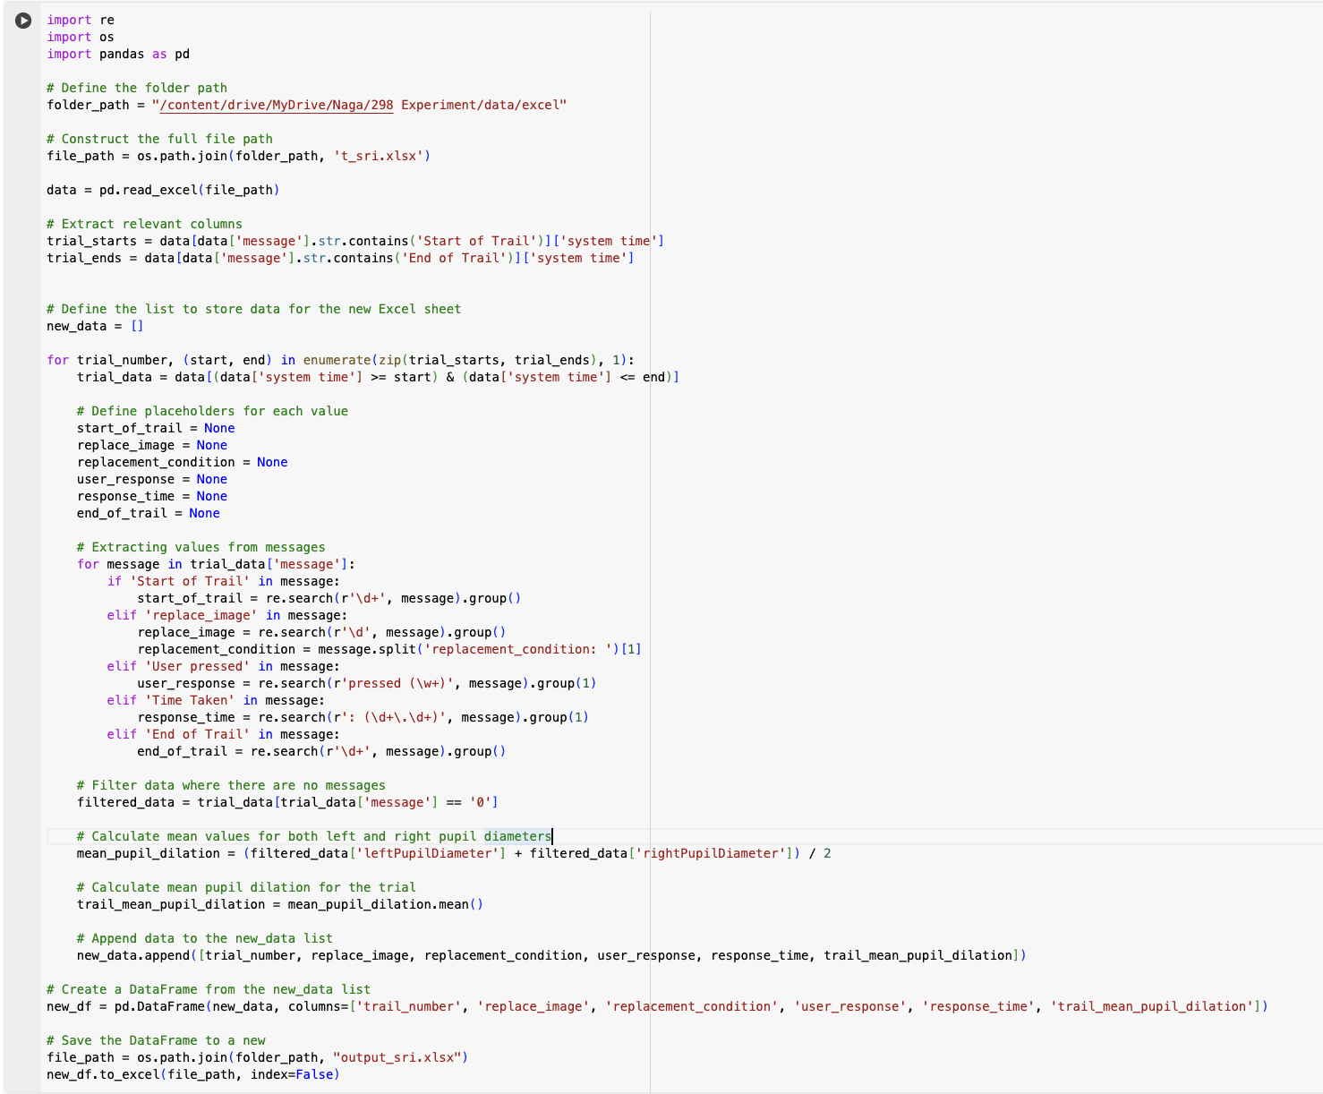
Processing eye-tracker data
in excel using Python

Slide 19
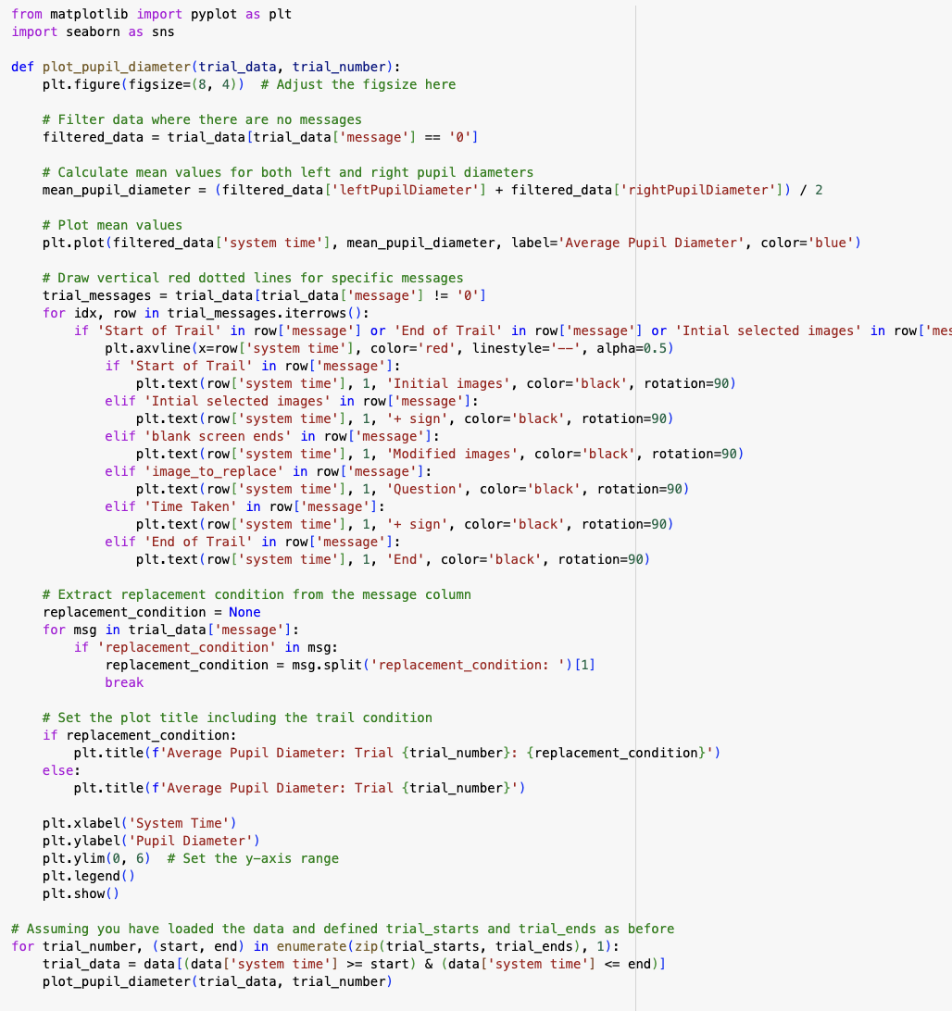
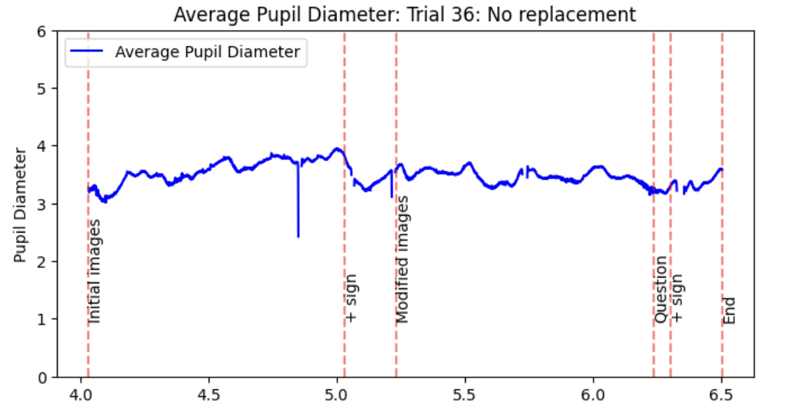
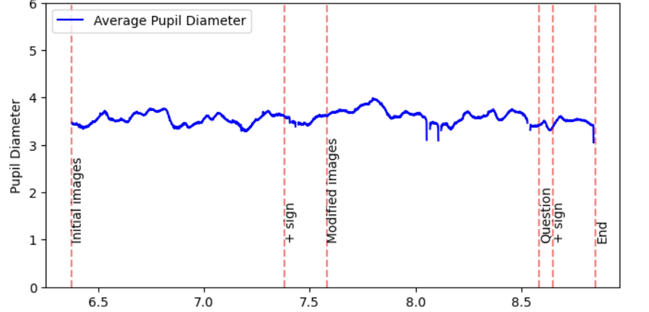
Results and Analysis
Pupil Dilation Patterns

Slide 20
T-Tests
Replacement Condition | P-value | t-value | df | Significance
FI>FI | 0.0007 | 4.336 | 14 | extremely significant
FI>FO | 0.4256 | 0.8207 | 14 | not statistically significant
FI>MI | 0.0001 | 6.8447 | 14 | extremely statistically significant
FO>FI | 0.0169 | 2.7105 | 14 | statistically significant
FO>FO | 0.0169 | 2.7105 | 14 | statistically significant
FO>MI | 0.0008 | 4.2363 | 14 | extremely statistically significant
MI>FI | 0.1639 | 1.4693 | 14 | not statistically significant
MI>FO | 0.0234 | 2.5426 | 14 | statistically significant
No replacement | 0.0586 | 2.0587 | 14 | not quite statistically significant

Slide 21
Highly Statistically Significant Differences | FI>FI, FI>MI, FO>MI | These conditions show extremely statistically significant differences with p-values well below the conventional significance level of 0.05. The large t-values (above 4) indicate a robust difference in pupil dilation between correct and incorrect responses, suggesting that participants reacted strongly to these specific image replacements.
Statistically Significant Differences | FO>FI, FO>FO, MI>FO | These conditions also show statistically significant differences with p-values less than 0.05 but greater than those in the highly significant category. The t-values are above 2 but below 4, suggesting a moderate difference in pupil dilation that participants could still reliably detect.
Not Statistically Significant | FI>FO, MI>FI | These conditions did not show statistically significant differences (p-values are above 0.05). The lower t-values (below 2) suggest that the changes in image replacement from Female Intellectual to Female Only, or Male Intellectual to Female Intellectual, did not impact pupil dilation markedly, indicating that participants might not perceive these replacements as distinct or challenging.
Borderline Cases | No Replacement | The condition where no image was replaced resulted in a p-value of 0.0586, which is just above the typical threshold for statistical significance (0.05). This suggests a trend toward significance, indicating that participants might have had some expectation of changes or were uncertain in trials without replacements, but this was not strong enough to be considered statistically significant.

Slide 22
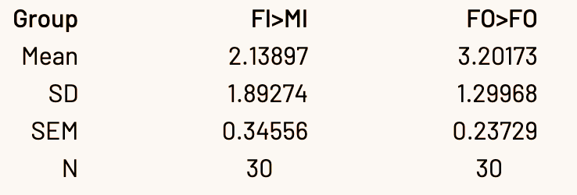
Participant | replacement_condition | user_C_response | user_I_response | Right_RT | Wrong_RT | mean__C_pupil | mean__I_pupil
P1 | FI>MI | 3 | 0 | 0.829 | 0.000 | 4.187 | 0.000
P2 | FI>MI | 2 | 1 | 0.771 | 0.702 | 3.401 | 3.470
P3 | FI>MI | 3 | 0 | 0.913 | 0.000 | 3.809 | 0.000
P4 | FI>MI | 1 | 2 | 1.111 | 0.897 | 3.040 | 3.166
P5 | FI>MI | 3 | 0 | 0.613 | 0.000 | 2.743 | 0.000
P6 | FI>MI | 3 | 0 | 0.613 | 0.000 | 2.743 | 0.000
P7 | FI>MI | 2 | 1 | 0.369 | 0.438 | 5.454 | 5.341
P8 | FI>MI | 3 | 0 | 0.593 | 0.000 | 2.620 | 0.000
P9 | FI>MI | 3 | 0 | 1.098 | 0.000 | 3.679 | 0.000
P10 | FI>MI | 3 | 0 | 0.526 | 0.000 | 2.513 | 0.000
P11 | FI>MI | 2 | 0 | 0.917 | 0.000 | 4.146 | 0.000
P12 | FI>MI | 3 | 0 | 0.921 | 0.000 | 4.058 | 0.000
P13 | FI>MI | 3 | 0 | 1.426 | 0.000 | 3.861 | 0.000
P14 | FI>MI | 3 | 0 | 0.915 | 0.000 | 2.918 | 0.000
P15 | FI>MI | 3 | 0 | 0.628 | 0.000 | 3.020 | 0.000
Participant | replacement_condition | user_C_response | user_I_response | Right_RT | Wrong_RT | mean__C_pupil | mean__I_pupil
P1 | FO>FO | 2 | 1 | 1.831 | 0.660 | 4.288 | 4.333
P2 | FO>FO | 0 | 3 | 0.000 | 0.706 | 0.000 | 3.466
P3 | FO>FO | 1 | 2 | 0.886 | 0.974 | 3.638 | 3.541
P4 | FO>FO | 1 | 2 | 0.518 | 0.896 | 3.311 | 3.288
P5 | FO>FO | 1 | 2 | 0.696 | 0.717 | 2.646 | 2.623
P6 | FO>FO | 1 | 2 | 0.845 | 0.668 | 4.161 | 3.972
P7 | FO>FO | 1 | 1 | 0.922 | 0.450 | 5.289 | 5.233
P8 | FO>FO | 2 | 1 | 0.645 | 1.090 | 2.610 | 2.660
P9 | FO>FO | 2 | 1 | 1.357 | 0.525 | 3.595 | 3.635
P10 | FO>FO | 2 | 1 | 0.727 | 0.845 | 2.596 | 2.717
P11 | FO>FO | 3 | 0 | 0.580 | 0.000 | 4.108 | 0.000
P12 | FO>FO | 2 | 1 | 1.331 | 1.197 | 4.112 | 4.018
P13 | FO>FO | 2 | 1 | 0.699 | 1.367 | 3.782 | 3.685
P14 | FO>FO | 1 | 2 | 1.386 | 0.942 | 2.830 | 2.902
P15 | FO>FO | 3 | 0 | 0.708 | 0.000 | 3.013 | 0.000
Condition | P-value | t-value | df | Significance
FO>FO vs FI>MI | 0.0039 | 3.1396 | 29 | very statistically significant

Slide 23
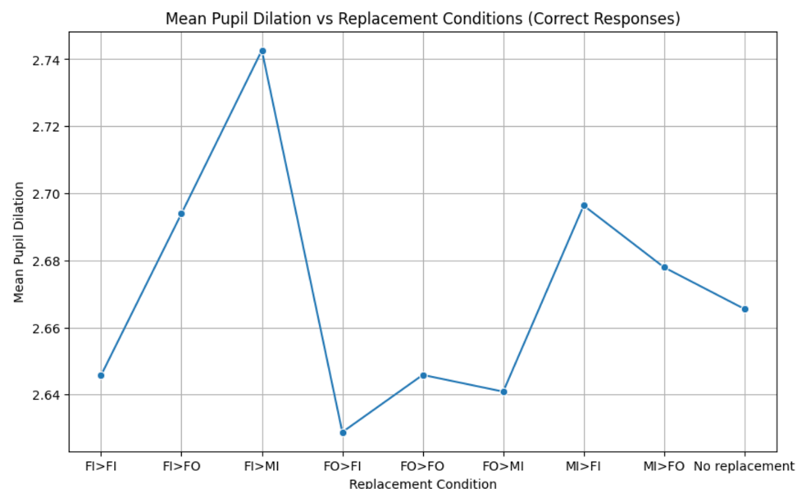
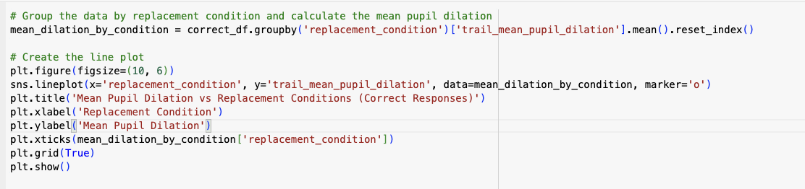
Cognitive Load and Assessment

Slide 24
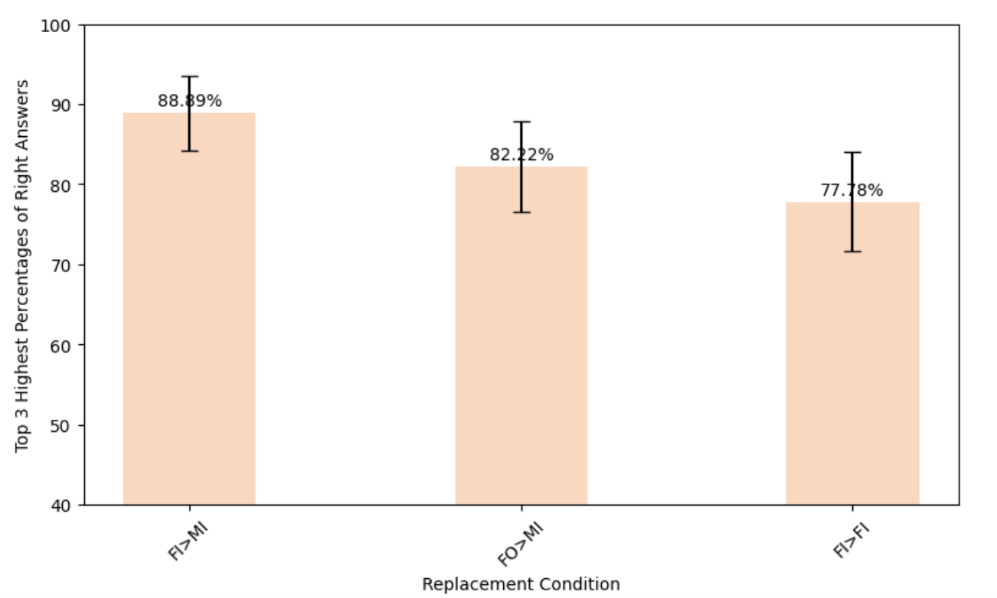
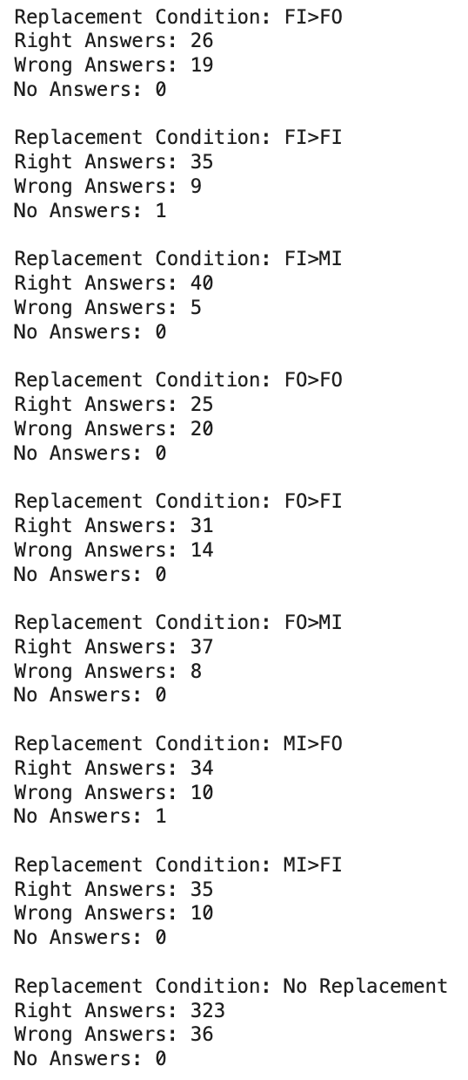
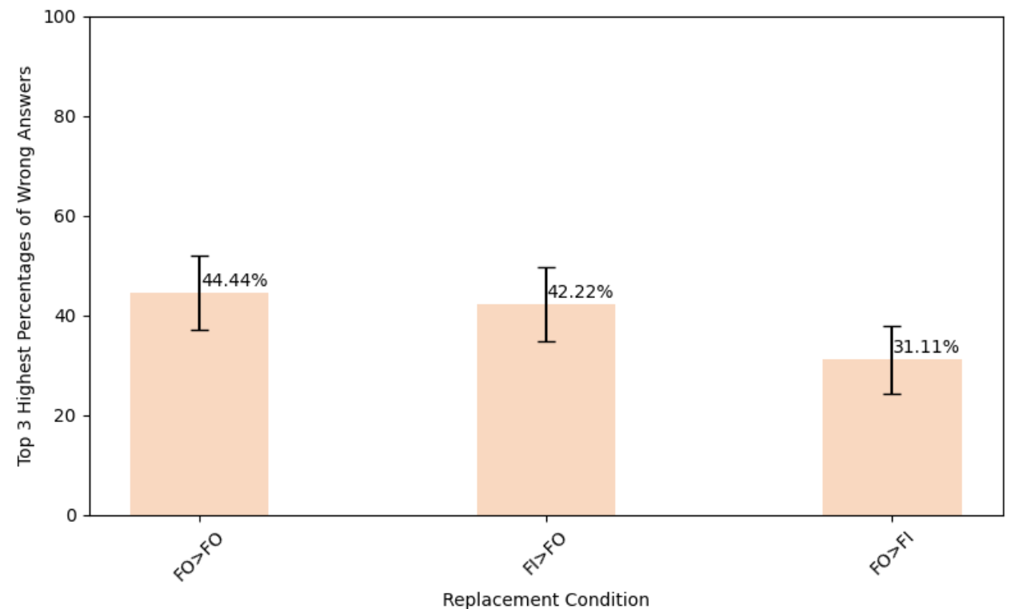
Response Accuracy by Replacement Condition

Slide 25
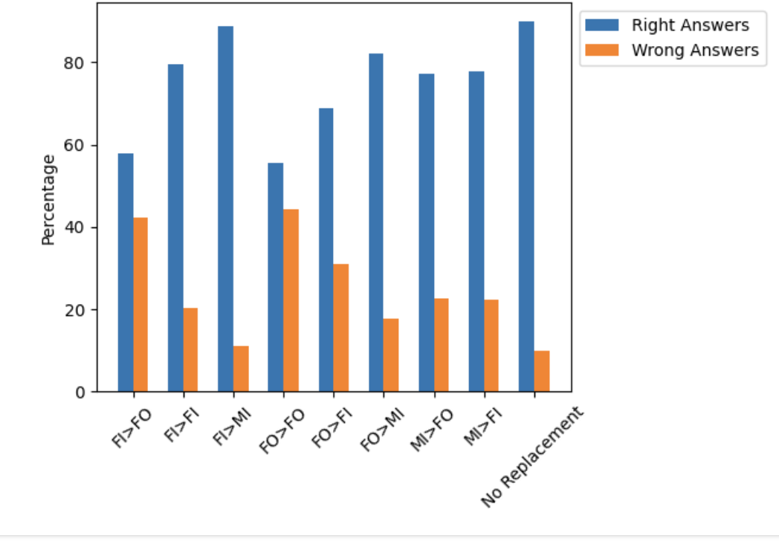
bars = plt.bar(conditions, percentages, color='#ffd7bd', width=0.4, yerr=standard_errors, capsize=5)
Percentages of Counts by Replacement Condition

Slide 26
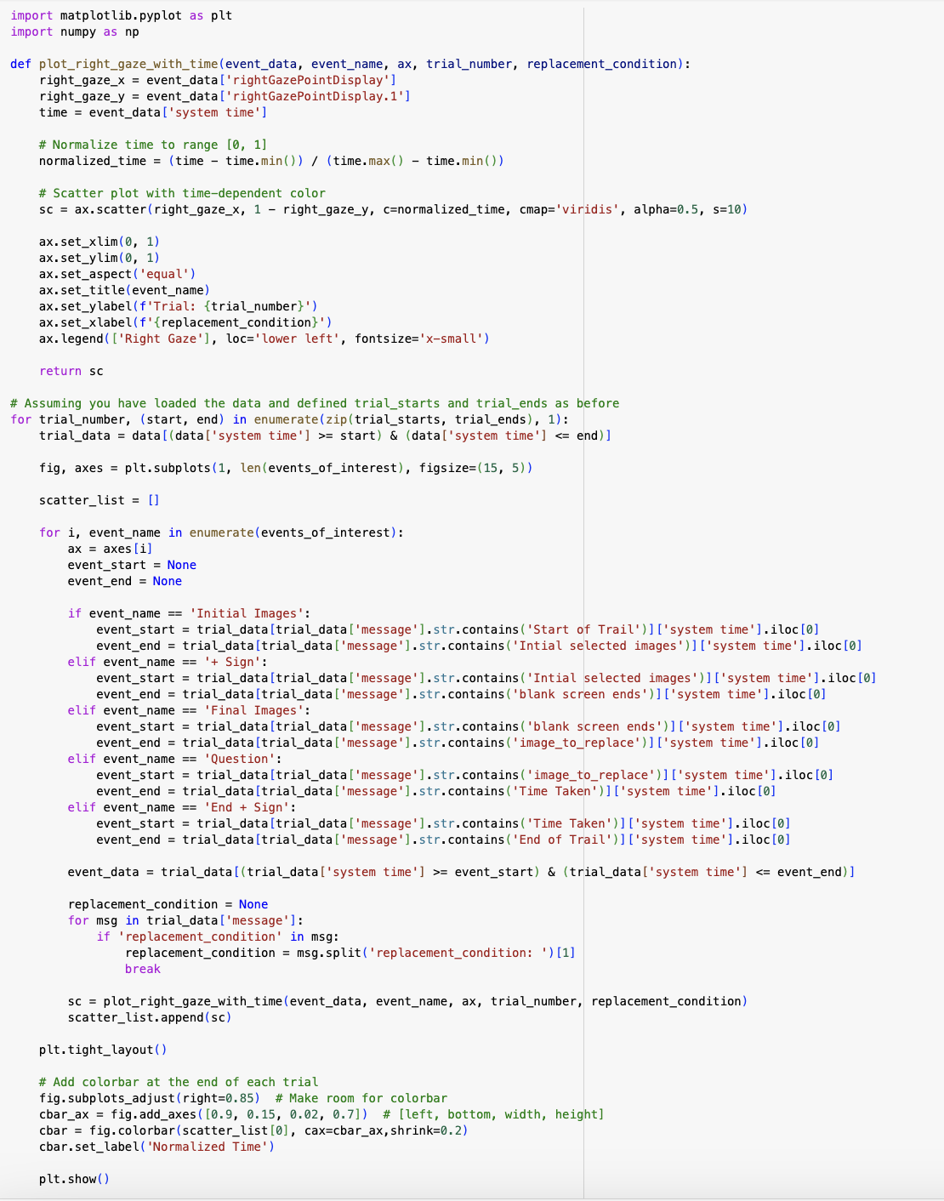
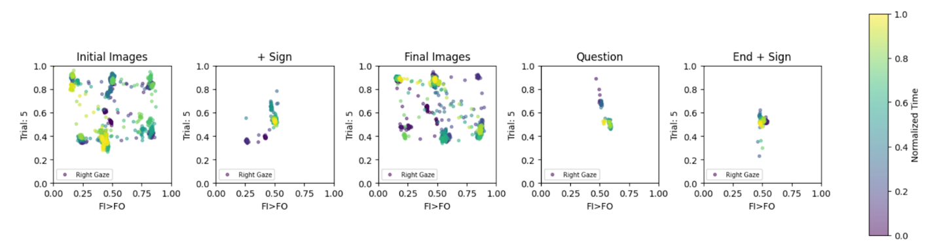
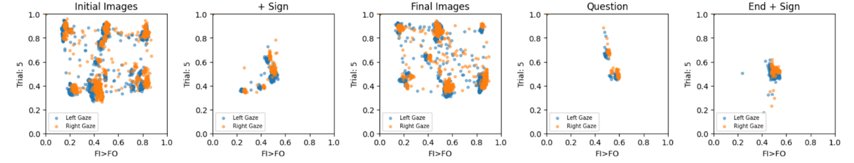
Visual Attention Patterns

Slide 27
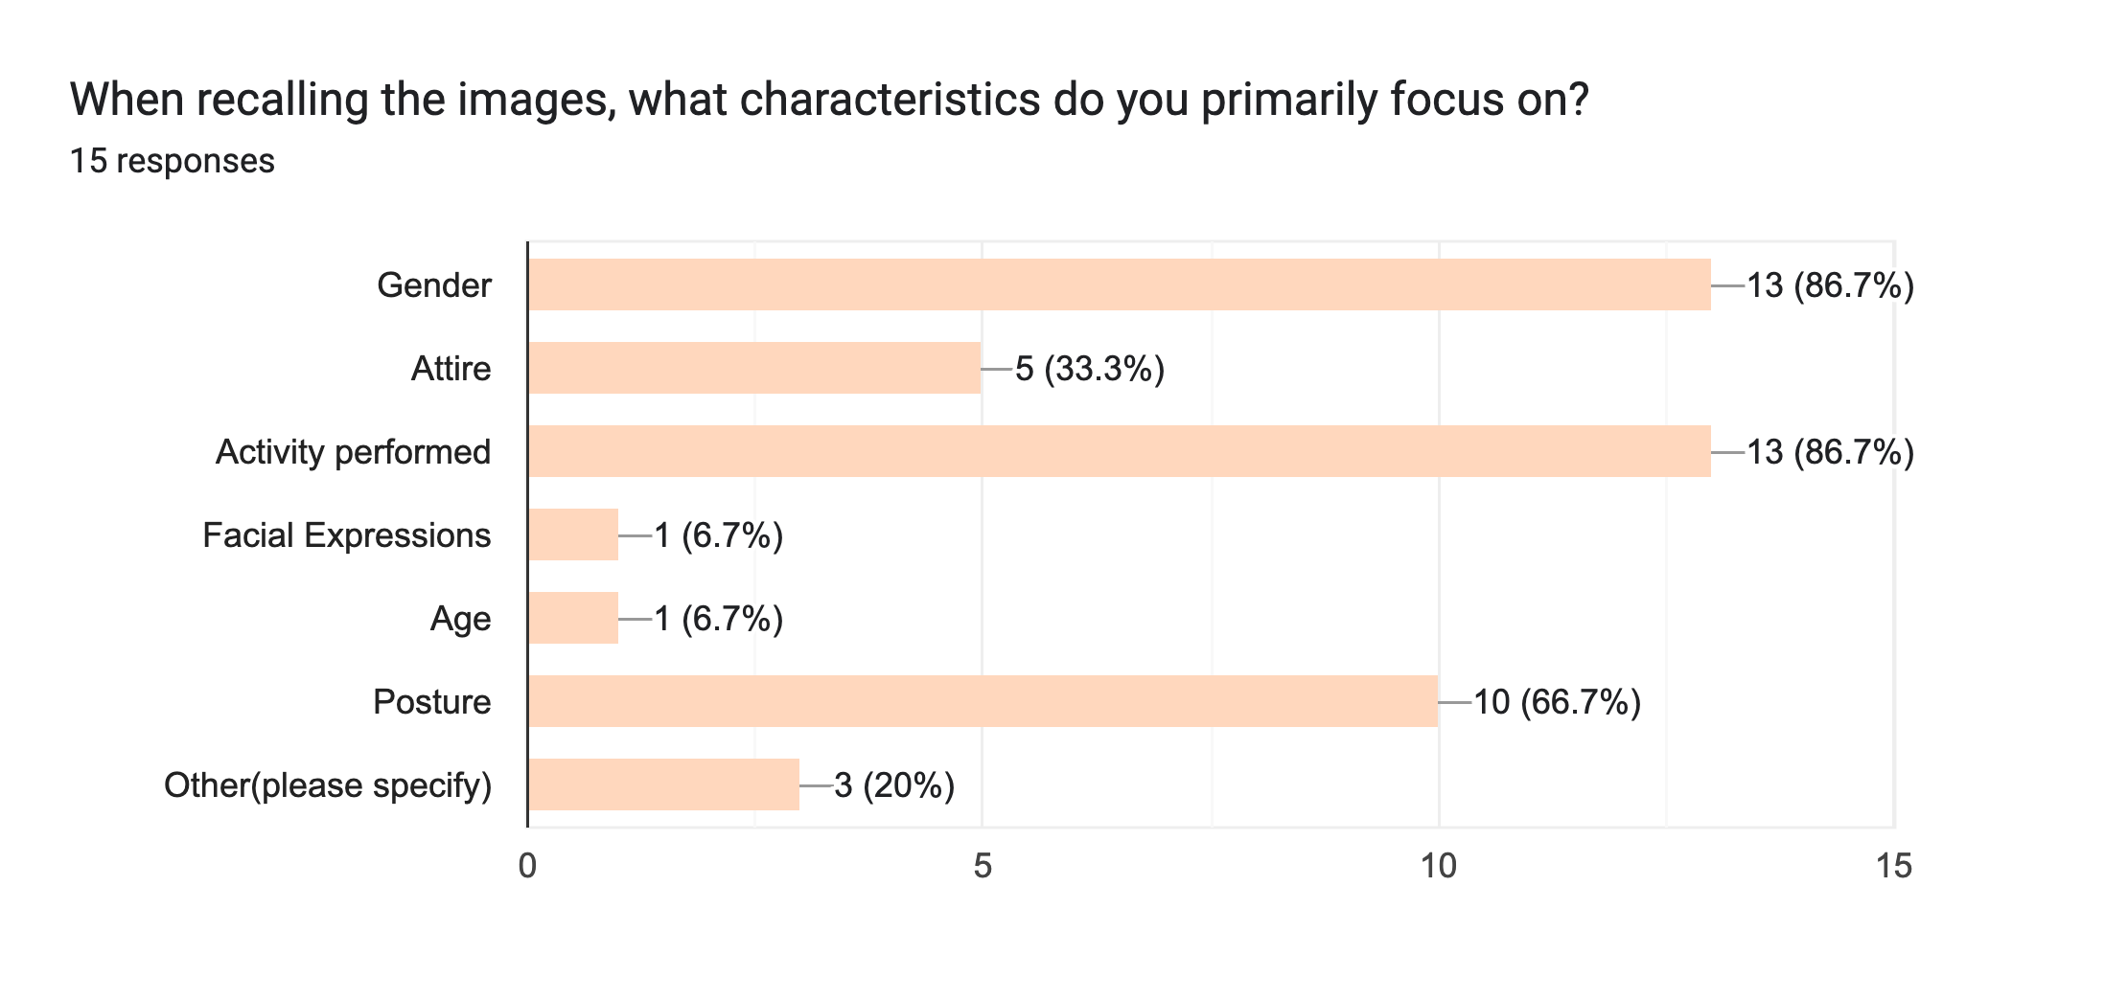
Qualitative Feedback from Participants

Slide 28

Conclusion
Key Insights and Implications
Impact of Gender and Role Stereotypes
Cognitive Load Dynamics
Visual Attention and Decision-Making
Methodological Contributions
Future Directions

